Slide 1
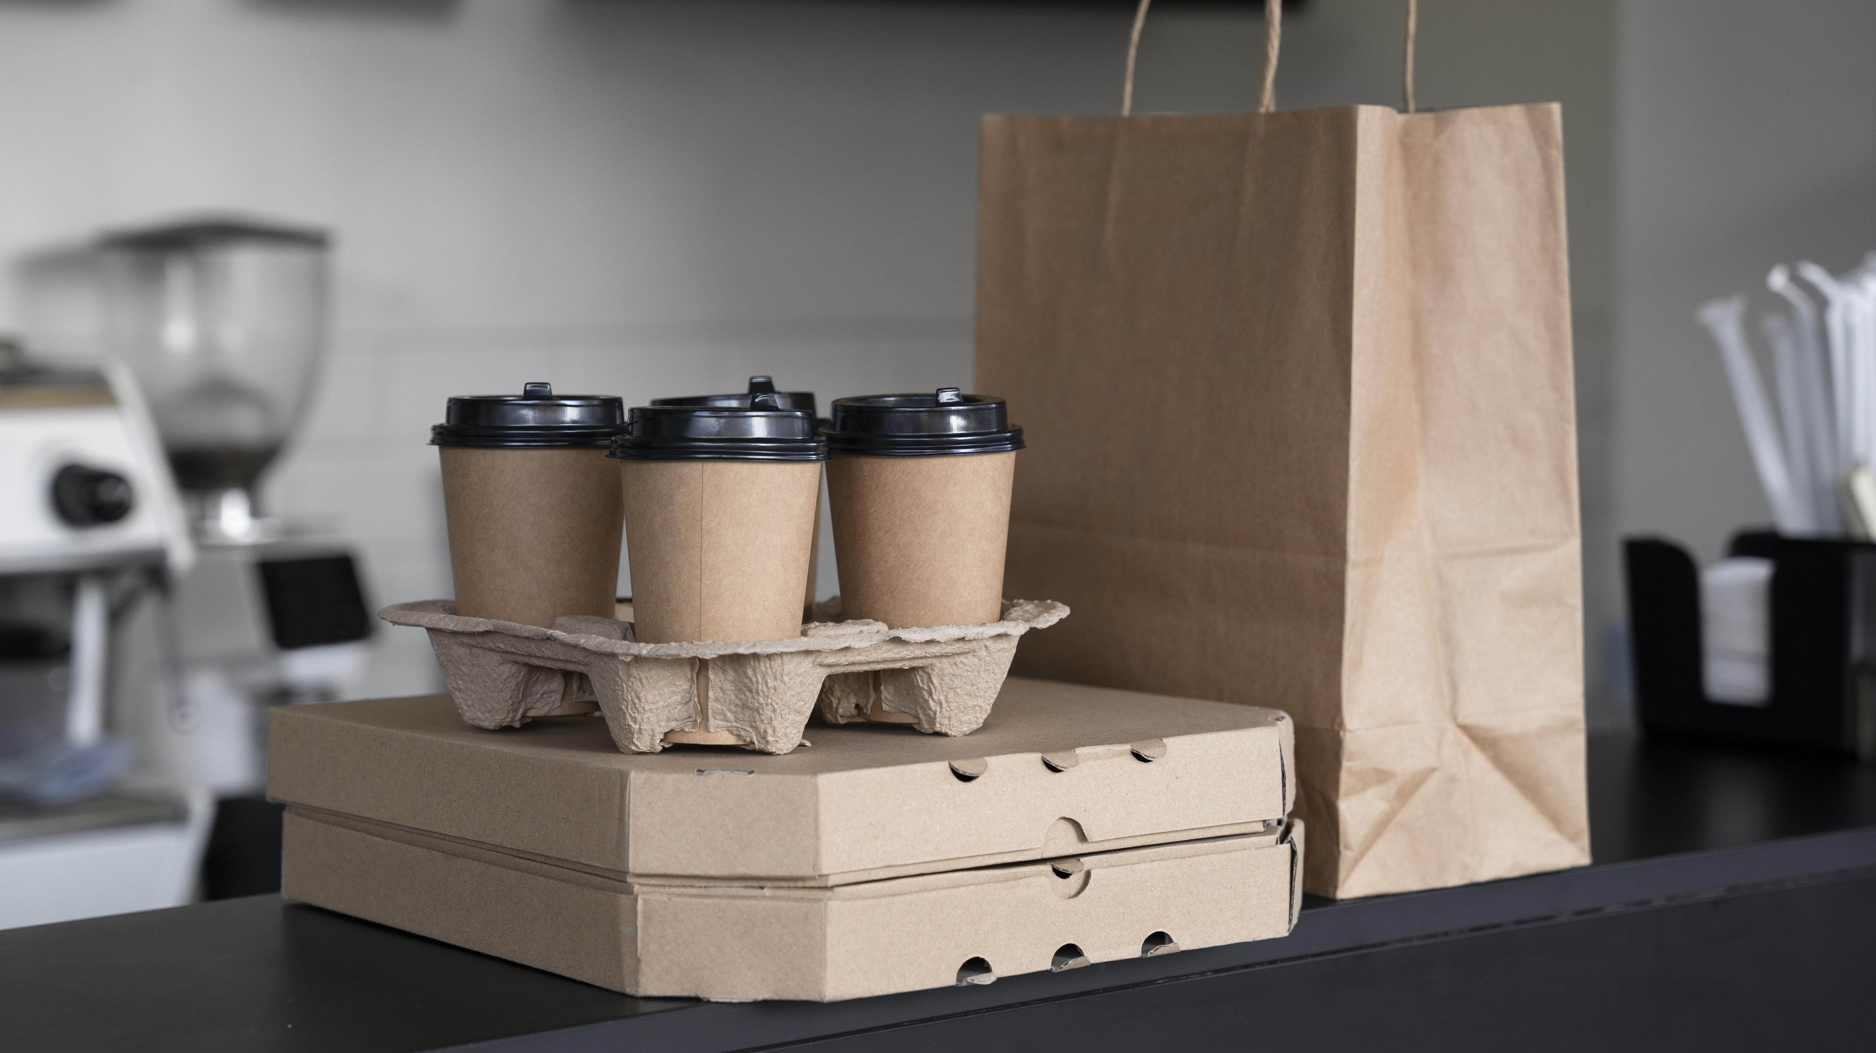
AGM Growth Initiatives
Gary Kong
Luis Garcia Lizaran
Notes:
Hi everyone. Luis and I are very happy to share the outcomes of our final project for W205.

Slide 2
Context of the assignment
Acme Gourmet Meals (AGM) is a thriving startup that emerged from the vision of Joy, a former sous chef with a passion for healthy, gourmet meals. Recognizing the market's demand for convenient yet nutritious food options, Joy established AGM to provide fresh, high-quality meals tailored to busy professionals' lifestyles.
Recognizing the company's need to embrace emerging technologies, the data science team, management is exploring the potential of NoSQL databases such as Neo4j, MongoDB, and Redis. Aligning with AGM's vision for future growth, your team aims to leverage these technologies to optimize operations, enhance customer experiences, and support innovative delivery methods, including public transportation integration and drone deliveries.
Additionally, management is exploring various growth levers to propel AGM's expansion:
Adding more pickup locations to improve accessibility and convenience for customers.
Utilizing public transportation, such as BART, to transport deliveries, mitigating traffic congestion and enhancing efficiency.
Implementing delivery drones and robots for localized deliveries, offering swift and convenient service within a limited range.
Exploring hybrid combinations, such as pickup locations at BART stations, to capitalize on foot traffic and streamline delivery logistics.

Slide 3
We evaluated potential sources of growth for AGM by considering the following questions
1
Should AGM expand its footprint of pickup locations?
2
What mode of transport (BART, drones, robots, and/or delivery vans) should AGM use for its delivery services?
Which mode to use for long-range transport?
Which mode to use for last-mile transport?
3
Based on the above, what would be the optimal model for AGM’s new business?
Where should AGM locate its pickup locations?
How should AGM transport meals from its kitchen to pickup locations? From pickup locations to customers?
What are the implications of this model e.g., how many potential new customers would be reached)?
4
How can technology (Neo4j, MongoDB, and Redis) play a role in implementing AGM’s growth strategy?
Notes:
To start off, we want to outline the key research questions that we are interested in, considering the context around AGM’s business and the brief
First, should AGM expand its footprint of pickup locations beyond just the Berkeley store?
Second, what mode of transport should AGM use for its delivery services? How should this differ for long-range vs. last-mile transport?
Third, what would be the optimal model for AGM’s new business? By this we mean:
Where should AGM locate its pickup locations?
How would food be transported?
What are the implications for the business, in terms of increasing the number of customers who could be served?
Finally, how can technology play a role in implementing AGM’s growth strategy?

Slide 4






we have made the following assumptions to conduct our evaluation
The primary objective of the business is to increase its customer base
The kitchen is located at the Berkeley store
All pickup locations are assumed to be both:
Direct point of sale (customers can pick-up food themselves)
Base for delivery (delivery vehicle can pick-up food at the location to deliver to customers)
AGM targets customers with higher incomes
Delivery drones and robots have a limited delivery range of 1 mile
Each pickup location can only service customers within a 5-mile range
Notes:
Before I delve in I’ll just outline key assumptions that we made in our analysis
First, the primary objective of the business is to grow by increasing its customer base (as opposed to say, increasing average order value per existing customer)
Second, the kitchen is located at the Berkeley store
Third, each pickup location is both a direct point of sale – i.e., places where customers can pick up their orders as well as a base for making deliveries from
Fourth, AGM targets customers with higher incomes
Fifth, delivery drones and robots have a limited delivery range of 1 mile
Finally, each pickup location can only service customers within a 5-mile radius

Slide 5
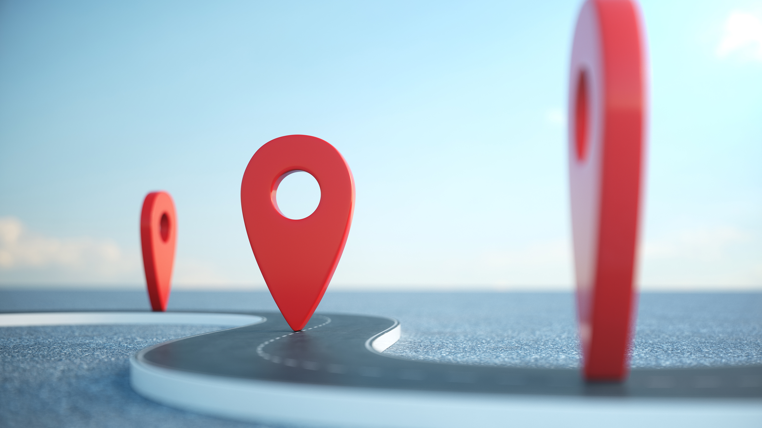
Should AGM expand its footprint of pickup locations?
Notes:
We’re now looking at our first business question: Should AGM expand its pickup locations?

Slide 6
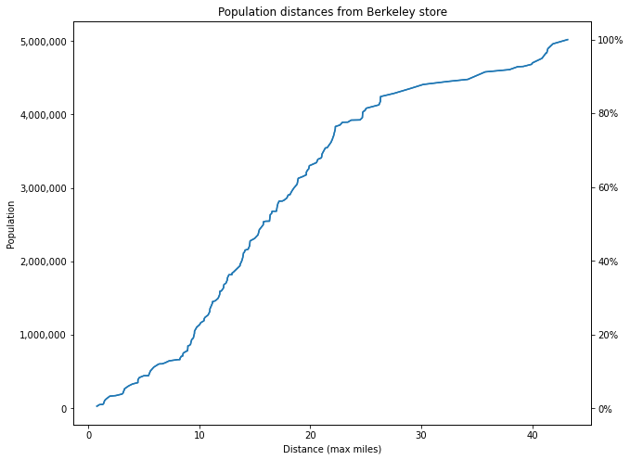
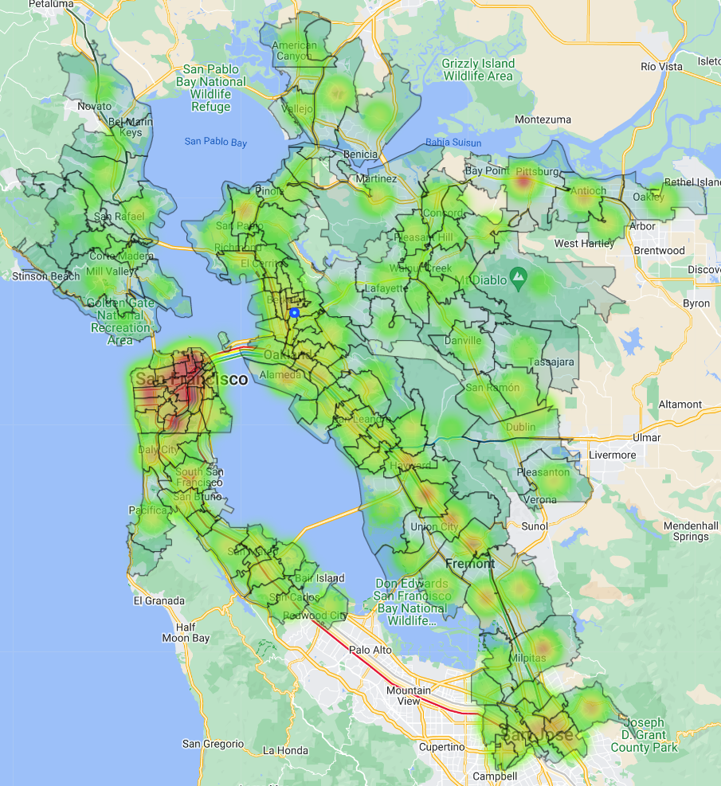
AGM will need to expand its pickup locations if it is to reach a larger proportion of the addressable population
1
Addressable Population
Population living in zip codes that are within 5 miles of any station within the stations.csv dataset +
Population in zip codes with current AGM customers
Addressable Population by Distance from Berkeley Store
Addressable Population by Zip Code
~15m
Only 8.3% of the Addressable population is within a 5-mile range of the Berkeley store
Low
High
Notes:
To evaluate this question, we assessed the proportion of the addressable population that lives within any given range of the Berkeley store.
We defined the addressable population as the populations that either:
Live in zip codes within 5 miles of any station within the stations.csv dataset OR
Live in zip codes with current AGM customers
The chart on the left cumulatively plots the addressable population by how far they live from the Berkeley store. If we assume that each pickup location can only service populations within a 5-mile range, we can see that AGM’s current footprint only enables it to reach ~8% of the addressable population
The chart on the right shows a heatmap of the addressable population by ZIP code
Red means higher population, Green means lower population
The small blue dot shows where the Berkeley store is
Again, you can see that there is quite large populations which are located quite far away from the Berkeley store such as San Francisco, which is located about 15 miles away
Therefore, there is potential to increase the number of customers who can be serviced by increasing the footprint of pickup locations

Slide 7
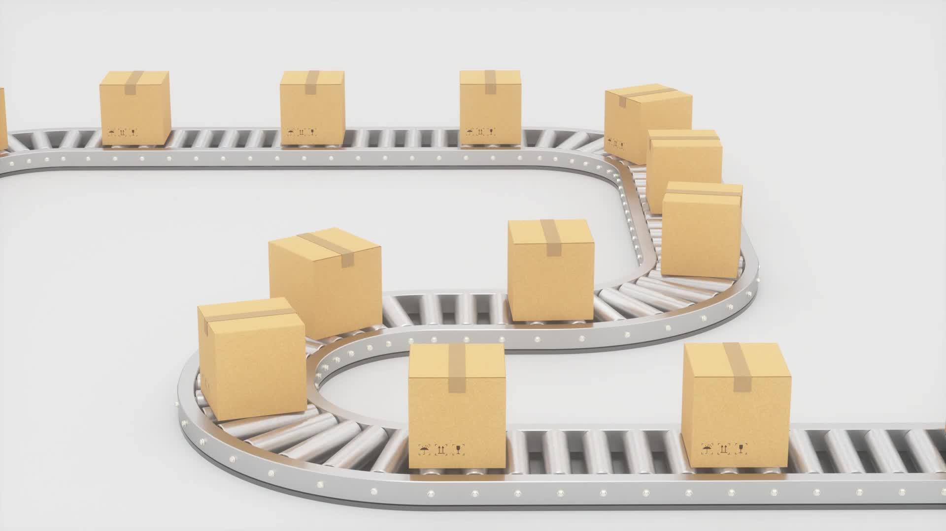
What transport options should AGM use for its delivery services?
Notes:
Next we wanted to evaluate which modes of transport AGM should use to expand its delivery services

Slide 8
AGM will need a combination of long-range and last-mile transport for its delivery services
2
AGM Delivery Model Options
 |  | Long-range Transport Options
 |  | BART | Delivery Vans
Last-mile Transport Options | Delivery Vans | BART + delivery trucks | Delivery vans only
 | Delivery Drones | BART + delivery drones | Delivery vans + drones
 | Delivery Robots | BART + delivery robots | Delivery vans + robots
Delivery drones and robots are considered unfeasible long-range transport options due to limited range (1 mile)
If BART is used as a long-range transport option, last-mile transport options will be required for both:
Delivery from kitchens to nearest BART station
Delivery from BART stations to customer
We have not considered other options such as delivery bikes based on the prompt of the project
Notes:
We evaluated both long-range and last-mile transport options.
The table here shows the options that we considered as potential options.

Slide 9
BART is the most suitable Long-range transport option given superior range, cost speed and environmental impact
2
 |  | Long-range Transport Options
 |  | BART |  | Delivery Vans
Evaluation Criteria | Range |  | 131 miles (total length of BART rapid transit lines) |  | 5 miles (assuming Peak delivery range)
 | Capacity |  | Assumed to be larger given use of rail |  | ~ 2,000 lbs
 | Cost |  | Low costs as it is a public service |  | Higher than BART due to taxes, tolls, fuel, and maintenance costs
 | Speed |  | 35 miles per hour (with stops) |  | 15 – 20 miles per hour (on arterial roads during rush hour)
 | Environmental Impact |  | BART system is electrically powered, with a large percentage of electricity generated from green energy |  | High emissions (if gas-powered) / Medium emissions (if electric)
 | Feasibility |  | A Caltrans study demonstrated that it is feasible to use BART instead of trucks in and out of San Francisco and Oakland airports |  | Commonly used. AGM already has delivery partners (e.g., Peak) that use vans
A 2014 CalTrans study found that there is scope to introduce freight services to BART:
For non-peak periods, slots for dedicated freight train insertions are available
For peak hours in non-commute directions, some trains could be used consisting of mixed freight cars and empty passenger cars
For peak periods in commute directions, the current schedule would need to be adjusted to accommodate freight trains
Adopting modern train control systems could increase capacity of BART and open up more slots
Attractiveness | Low | Medium | High
Sources: bart.gov; San Francisco County Transportation Authority; Lu et al., (2015); Caltrans DRISI (2014)
Notes:
We evaluated trade-offs between using BART or delivery vans for long-range transport using several criteria: range, capacity, cost, speed, environmental impact, and feasibility
We found that BART outscores delivery vans across all criteria apart from feasibility.
Feasibility of using BART is a rather open question, but we assumed that it would be feasible given the prompt of the assignment.
Indeed, a CalTrans study from 2014 found that it is indeed possible to introduce freight services to BART, with some caveats.

Slide 10
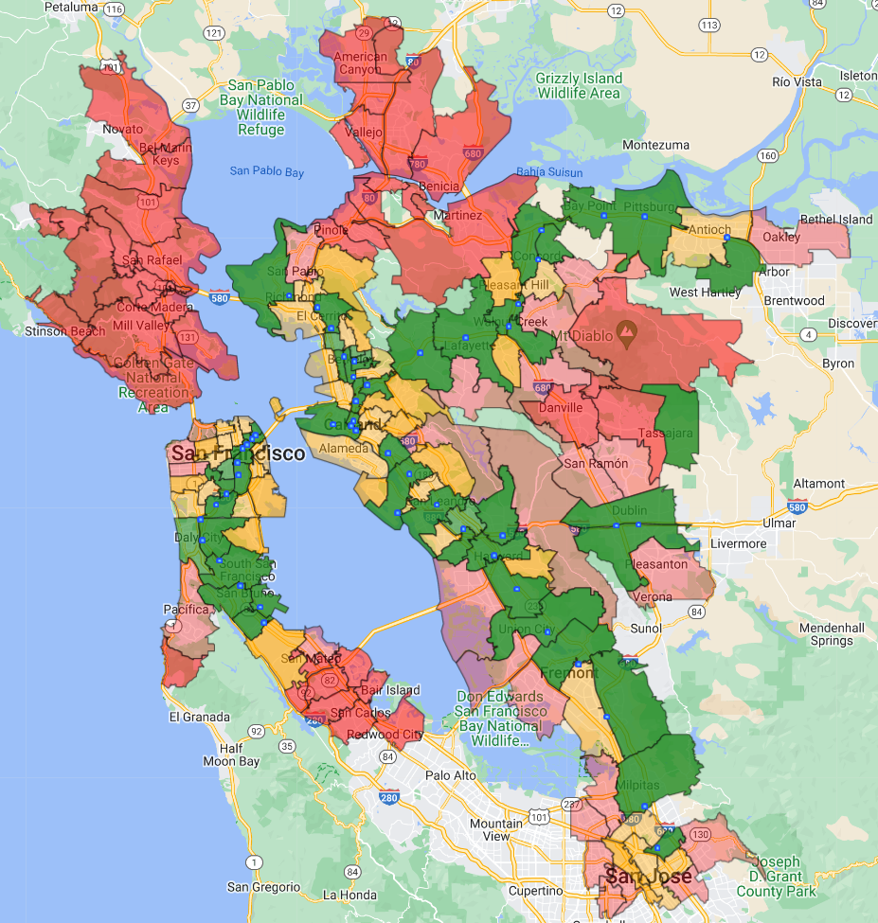
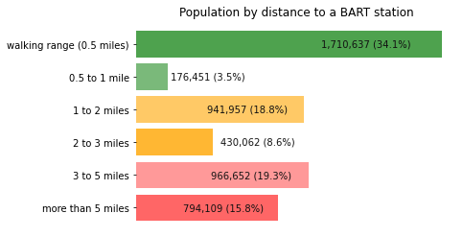
Last-mile transport is needed as ~65% of the addressable population live beyond walking distance of BART stations
2
ZIP codes by distance to nearest BART station
Addressable population by distance to a nearest BART station
~65% of the addressable population live beyond walking distance of BART stations
Notes:
We then quantified the need for last-mile transport by measuring the distance of ZIP codes to the nearest BART station, and found that 65% of the addressable population are not within walking distance of a BART station.
The heatmap on the left shows Bay Area zip codes colour-coded by distance to the nearest BART station. The heatmap’s color coding follows the chart on the right, so dark green means the ZIP code’s centroid is within walking range (less than 0.5 miles) to the nearest BART station, and so forth.
If you look at the chart on the right, you will see that only about a third of the addressable population lives within walking distance of a BART station, which means that to serve the rest of the addressable population, AGM will need last-mile transport in addition to using BART to transport goods.

Slide 11
we recommend using delivery vans for last-mile transport mainly due to range and feasibility concerns
2
 |  | Last-Mile Transport Options
 |  | Delivery Vans |  | Delivery Drones |  | Delivery Robots
Evaluation Criteria | Range |  | 5 miles per delivery |  | 1 mile per delivery |  | 1 mile per delivery
 | Capacity |  | ~ 2,000 lbs |  | ~ 4 – 6 lbs |  | ~20 lbs
 | Cost |  | $5 – 12 per delivery* |  | $1.99 per delivery** |  | $1.99 per delivery^
 | Speed |  | 15 – 20 miles per hour |  | 40 – 60 miles per hour |  | 3 – 4 miles per hour
 | Environmental Impact |  | High emissions (if gas-powered) / Medium emissions (if electric) |  | Low emissions (electrically powered) |  | Low emissions (electrically powered)
 | Feasibility |  | Commonly used. AGM already has delivery partners (e.g., Peak) that use vans |  | Pilots in Bay Area but no commercial services are yet available. Without FAA exemption, UAV must be in line of sight and can only be flown in Class G airspace (not all areas) |  | Pilots in Bay Area but commercial services not yet available. In San Francisco, companies are limited to three robots each, only nine of which are allowed to traverse the whole city
Attractiveness | Low | Medium | High
Note: * $5 per delivery based on $2.5 average van cost per mile, and assuming average delivery distance of 2 miles. $12 per delivery based on Peak Delivery 18% cut and average sale value of $67; * Based on Ark Invest estimates for Amazon Prime Air of $1 cost per delivery + assumed margin) ^ As quoted by Starship Technologies Sources: futurism.com; Technology Review; FAA; practicalecommerce.com; makeuseof.com; techcrunch.com; Ark Invest; Method.me
Notes:
We evaluated the different last-mile transport options using the same criteria as before.
I won’t go into detail but there are three things to highlight.
First, delivery vans have much higher range than drones or robots. As we will explain in the next slide, this has a significant impact on the number of pickup locations that would be needed
Second, delivery vans seem to have quite higher costs than drones or robots
The lower end of the estimate of $5 per delivery is based on average cost of $2.5 per mile, and average delivery distance of 2 miles
The higher end of the estimate of $12 is based on Peak Delivery’s 18% commission, since order values are on average $56 in the Berkeley delivery trial run
We expect that figures would be closer to the lower range as we assume there would be scope to negotiate fees with Peak Delivery
Third, feasibility is low for delivery drones and robots
There are no commercial services available for either of these options in the Bay Area
There are strict regulations for both drones and robots that are likely to limit scalability of these options
Considering all this, we believe that delivery vans are the best last-mile transport option

Slide 12
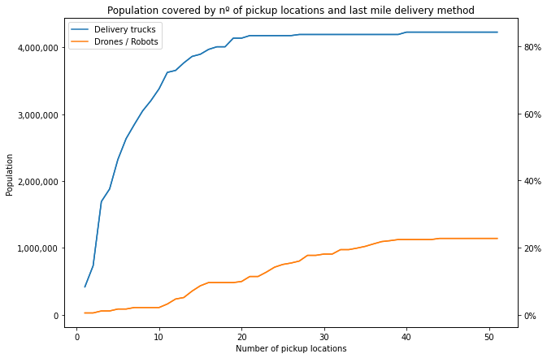
higher running costs of vans vs. to drones/ robots is offset by need for fewer pickup locations using vans
2
Estimated Population Served with 9 Pickup Locations, by Last Mile Delivery Method*
Addressable Population Served by No. of Pickup Locations and Last Mile Delivery Method
 | # | %
Delivery Vans (5 Mile Radius) | ~3,200k | ~64%
Delivery Robots/Drones (1 Mile Radius) | ~110k | ~2%
Note: *Assumes BART stations are used as pickup locations and station selection is made by a simulation choosing the set of stations which minimizes average distances from stations to population. Takes the average of top 9 stations and population served by each depending on 1- or 5-mile radius used
Notes:
We also considered the implications of using vans vs. robots or drones in terms of the number of pickup locations needed.
The chart on the right shows the population served on the Y axis, by number of pickup locations on the X axis. The blue line is for delivery vans, and orange is for robots or drones
Here the order of selection of stations is based on an algorithm designed to choose the set of stations that minimize average distances from stations to the population.
Key points here:
Using delivery vans, AGM reaches 64% of the addressable population with just 9 stations. If we included all stations, about 85% of the population could be served
Using delivery robots or drones, AGM only reaches 2% of the addressable population with 9 stations. If we included all stations, less than a quarter of the population could be served
So, even though running costs of delivery vans is higher than robots or drones, AGM would need far fewer pickup locations to serve the same amount of people, and can also address a wider customer base overall.

Slide 13
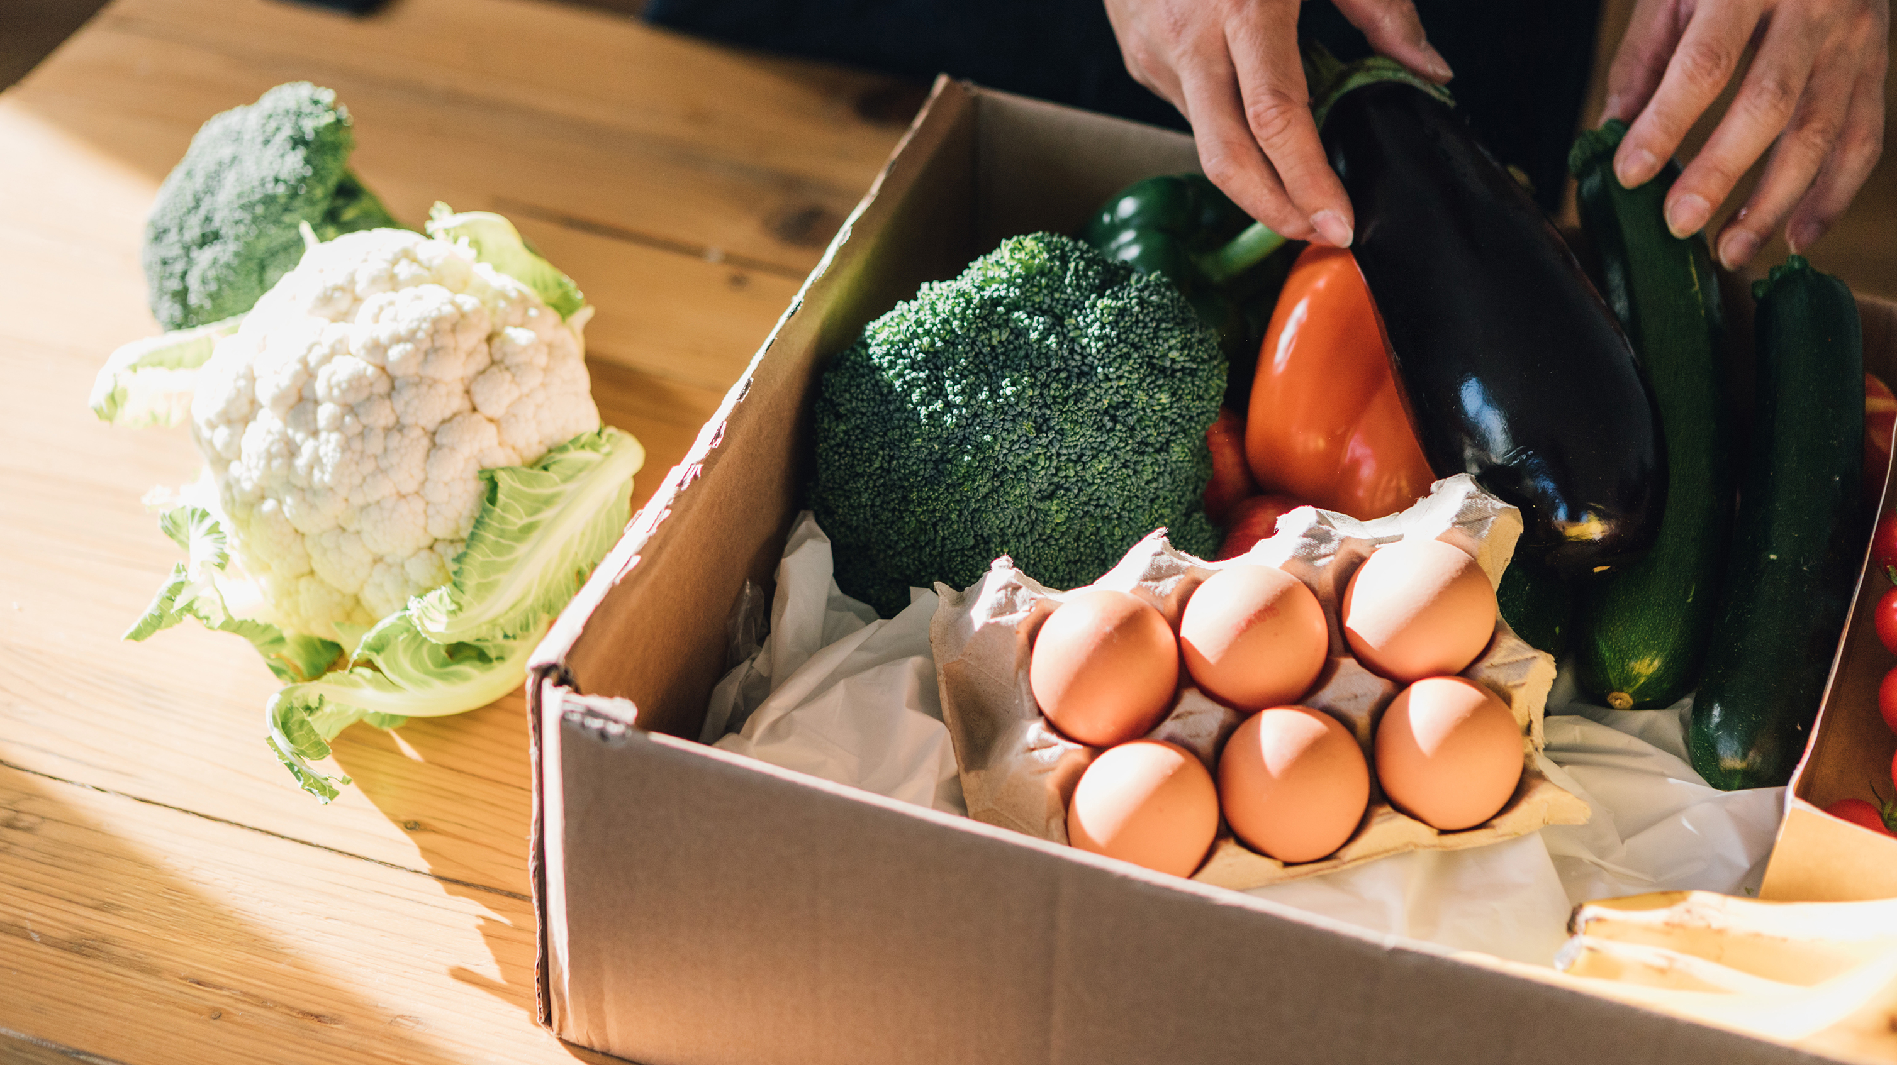
What would be the optimal model for AGM’s future business?
Notes:
Then, it comes our next question, What would be the optimal model for AGM’s future business

Slide 14
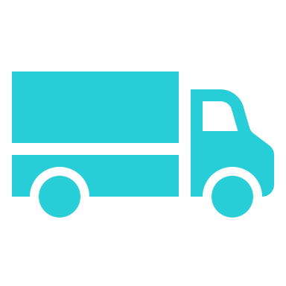
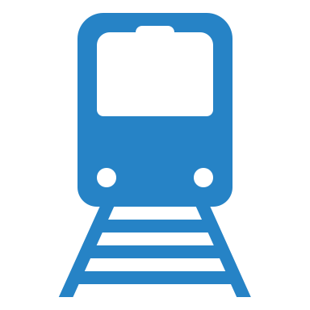


New pickup locations should be in BART stations due to ease of access, customer footfall and convenience
3
BART delivery model
Benefits of placing pickup locations in BART stations
Kitchen
Ease of Access
Locating pickup locations in BART stations enables immediate access to BART infrastructure for transporting food from kitchens and in between BART stations
5 miles
5 miles
Customer
Customer
Customer
Customer
Customer
Customer
Pickup location (BART station)
Berkeley BART station
Pickup location (BART station)
Customer
Customer
Customer Footfall
BART stations are typically located in areas with high customer footfall, with associated benefits for sales
Meals are delivered from AGM’s kitchens to selected BART stations or existing stores (pickup locations) each day using a combination of vans and BART
Customers can either pick up food from pickup locations (selected BART stations/existing stores) or arrange for delivery at any time
For customers within a 5-mile radius of a pickup location, deliveries are serviced from the nearest pickup location using traditional food delivery trucks
Convenience
Customers regularly pass by BART stations during daily commute times, so picking up meals can be done regularly with minimal disruption to customers’ routines
Notes:
We believe that pickup locations should be in BART stations because of ease of Access, customer footfall, and convenience.
In our model, kitchens will prepare meals and deliver them to selected BART stations or stores using both vans and the BART network. Customers can order for delivery or directly pick up food from pickup locations. The deliveries are served from the nearest pickup location, as long as the customer is within a 5-mile range.
The key benefits of this model are:
By placing pick up locations in BART stations, we leverage the BART infrastructure for transporting food, both from kitchens to pickup locations and in between BART stations
Also, we will strategically select stations with high customer footfall, which will improve sales without incurring extra costs like advertising costs

Slide 15
We ranked the attractiveness of bart stations based on centrality, population and household income
3
Criteria | Rationale | Weight
Betweenness centrality | Stations with high betweenness centrality within the BART network are more likely to be suitable ‘hubs’ | 25%
Number of lines passing through station | Stations with a higher number of lines passing through are more likely to have higher foot traffic. They are also likely to be transit points for customers changing between lines (i.e., convenient locations to pick-up food) | 15%
Population within a 5-mile radius (Distance-weighted) | Stations which reach larger populations are more likely to have higher demand | 30%
Average household income for zip-codes within a 5-mile radius (Distance + Population-weighted) | AGM’s business model is targeted towards more affluent customers, so areas with higher average median income are likely to have a larger number of target customers | 30%
When choosing pickup locations, we optimized to make all stations at least 5 miles apart from each other to avoid redundancy and overlaps in catchment areas
Population and household incomes were weighted according to distance of zip codes to each station:
Greater weight assigned to zip codes located closer to each station vs. those located further away
Accounts for higher importance of nearby populations
For distance-weighted population scores, a log transformation was applied to account for skew driven by outliers
All metrics were then normalized to a 0-100 scale using Max-Min normalization
Notes:
For selecting the best pickup location network, we ranked each store with a composite index considering betweenness centrality, number of lines passing through the station, population and household income, applying different weights to each feature.
The table shows the rationale and the weight for each feature.
Once we had the score for each pickup location, we selected the stores from top to down scores constraining the selected station to be at least 5 miles away from other.
Population and income were weighted according to distance to each station, and in the case of population, a log transformation was applied to account for high skew on data.
Also, all metrics were normalized to a 0-100 scale using max-min normalization

Slide 16
Based on our criteria, we identified nine most attractive stations and recommend a phased roll-out of these
3
Target pickup locations for AGM expansion, actual and normalized values (0-100 scale)**
 | Station |  | Betweenness Centrality | Number of Lines Passing Through | Population Within 5 Miles* | Average Household Income Within 5 Miles (Distance-weighted) |  | Total Score
 | Weights |  | 25% | 15% | 30% | 30%
Phase I (Tier 1 Locations) | Orinda |  | 4,997 (82) | 1 (0) | 191,812 (38) | $212,903 (100) |  | 62
 | 24th Street Mission |  | 2,829 (45) | 4 (100) | 921,187 (67) | $129,453 (41) |  | 59
 | MacArthur |  | 5,999 (100) | 3 (66) | 504,427 (37) | $92,237 (15) |  | 50
Phase II (Tier 2 Locations) | South Hayward |  | 2,432 (38) | 2 (33) | 266,634 (100) | $90,035 (14) |  | 49
 | Coliseum |  | 4,306 (70) | 4 (100) | 416,742 (27) | $72,117 (2) |  | 41
 | Bay Fair |  | 3,348 (54) | 3 (66) | 329,162 (29) | $81,764 (8) |  | 35
Phase III (Tier 3 Locations) | Colma |  | 1,873 (29) | 2 (33) | 488,088 (37) | $105,157 (25) |  | 31
 | Fremont |  | 1,592 (24) | 2 (33) | 315,645 (21) | $133,465 (44) |  | 31
 | Walnut Creek |  | 3,925 (64) | 1 (0) | 199,253 (8) | $121,050 (36) |  | 29
Notes: * Populations between stations may overlap. Figures shown are actual population values. Normalized scores are based on distance-weighted populations; ** 0-100 scale based on Max-Min normalized values for all BART stations
Notes:
The result of the previous process is shown in this table.
Each feature is scored 0 to 100 and weighted to produce a final score.
We have also divided the expansion into 3 phases, grouping the stations into tier 1, 2 and 3 locations based on their scores.

Slide 17
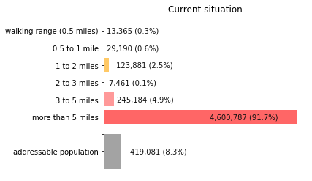
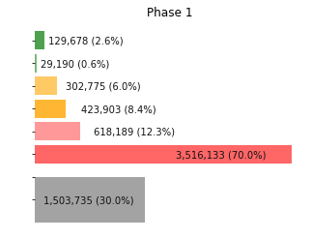
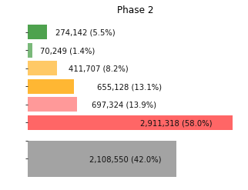
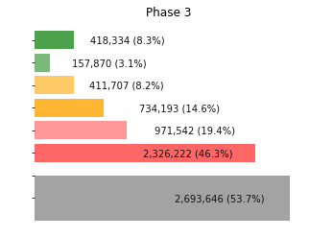
The nine target stations, when combined with delivery services would enable AGM to reach ~55% of the addressable population
3
Distribution of addressable population, by distance from nearest AGM pickup location
Phase I (3 Additional Pickup Locations)
Phase II (6 Additional Pickup Locations)
Phase III (9 Additional Pickup Locations)
Current Situation
Within 5-miles
Notes:
With this distribution, we convert the initial status of the Berkeley store, when only 8.3% of the total addressable population could be targeted, as shown in the grey bat of the chart on the left, into a 30% with phase 1 stations, 42 with phase 2 and finally, 53% with phase 3.

Slide 18
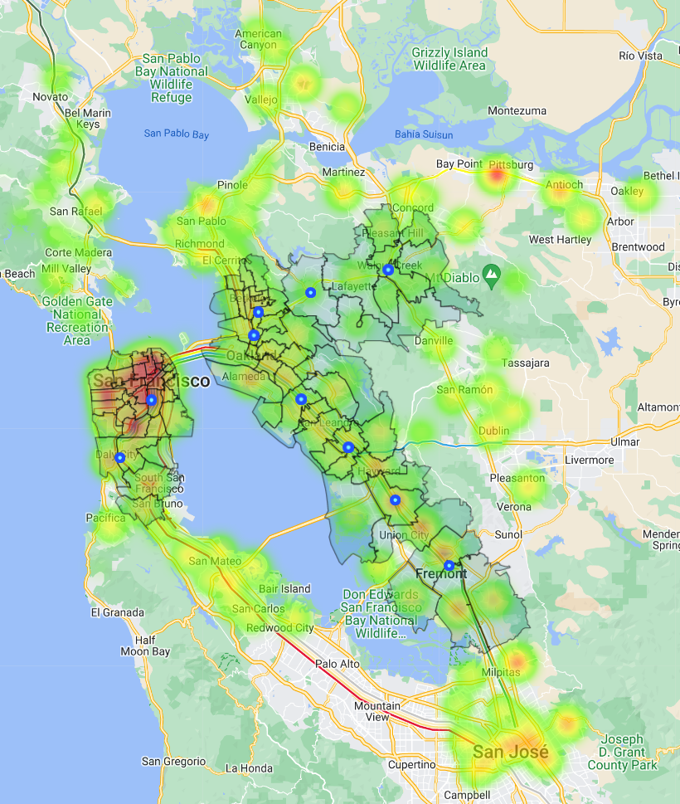
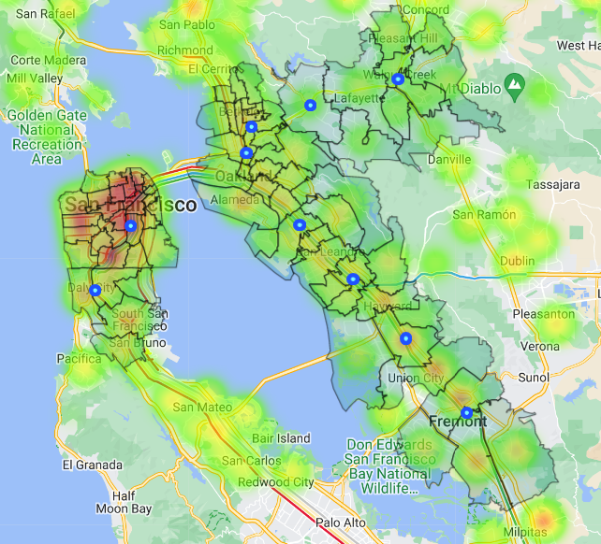
Locations of The nine target stations are spread out well across the Bay Area
3
Addressable Population by Zip Code
Walnut Creek
Orinda
Berkeley
McArthur
24th Street Mission
Coliseum
Bay Fair
South Hayward
Colma
Fremont
Low
High
5 miles
Phase I
Phase II
Phase III
Boxed zip codes: Within 5-mile range of pickup location
Notes:
We can see that stations are well spread out across the bay area, and phases 1 and 2 are
Phase 1 locations are more centrally located targeting highly populated areas
Phase 2 locations are more on the periphery and even more so for phase 3

Slide 19

What is the role of technology in implementing AGM’s growth strategy?
Notes:
Finally, our last question is about the role of technology in implementing the AGMs growth strategy.

Slide 20



Neo4J, MongoDb and Redis each has a role in realizing AGM’s growth plans
4
Type of database | Graph database | NoSQL document-oriented database | NoSQL in-memory key-value database
Business case | Determining optimal routes to transport goods (shortest path): Shortest BART route from kitchen to pickup locations Shortest road route from pickup locations to delivery customers | Business intelligence and analytics: Predetermined views with different hierarchies of analysis (e.g., by store, customer, station) accounting for business reporting needs Storage of additional ad hoc documents for later investigation | Real-time order management systems: Listing queue of customer orders that need to be fulfilled Real-time analytics in order fulfillment to monitor metrics such as time from order to delivery
Benefits vs. Traditional Relational Database | Directly represents data in a graph data structure Built-in graph algorithms Faster queries (for graph-based problems) | All data can be captured in a single JSON-like file (vs. multiple tables) Flexibility Faster queries | Extremely fast Read and Write operations: data stored in primary memory
 | Flexibility (Schema-Less) + Supports Horizontal Scaling + Accessibility and Reliability
Sources: Neo4j; MongoDB; Redis
Notes:
Here, we focused on the use of three technologies, Neo4j, MongoDB and redis.
Neo4j is a graph database, it has been used to determine the betweenness centrality of stations and could also serve to determine optimal routes to transport goods, from kitchens to pikup locations od road routes from pickup locations to delivery customers.
It represents data in a graph structure, has built in graph algorithms and enables faster queries for graph based problems
Mongo Is a No SQL document oriented database, AGM could use it for business intelligence and analytics. This databases can provide multiple points of view, like store, customer, stations to account for business reporting needs. Apart from storage of addictional ad hoc documents. The key benefits are that data can be captured in a single JSON-like file, with high flexibility and can provide faster queries.
Redis is an in-memory key-value database, it could be used in real time order management systems, like listing queue of pending orders or real time analytics. It is extremely fast.
All
Because they are all schema-less, it is flexible to make changes as business requirements evolve
They can be more cost-effective as they support horizontal scaling (i.e., no need to upgrade server but can rather add new nodes/clusters to scale up)
Data is more accessible and reliable as data can be replicated across nodes instead of stored in a central server

Slide 21
Thank You

